Slide 1
Structural variation of 30,659 bipolar and schizophrenia patients identifies novel genetic insights
Robert Ye
On behalf of the Whole Genome Sequencing for Psychiatric Disorders Consortium (WGSPD)
Neale and Talkowski Labs
Notes:
Good afternoon everyone, today I'll be talking about how structural variation from the largest deep whole genome sequencing cohort of bipolar and schizophrenia patients can help us identify novel genetic insights.

Slide 2
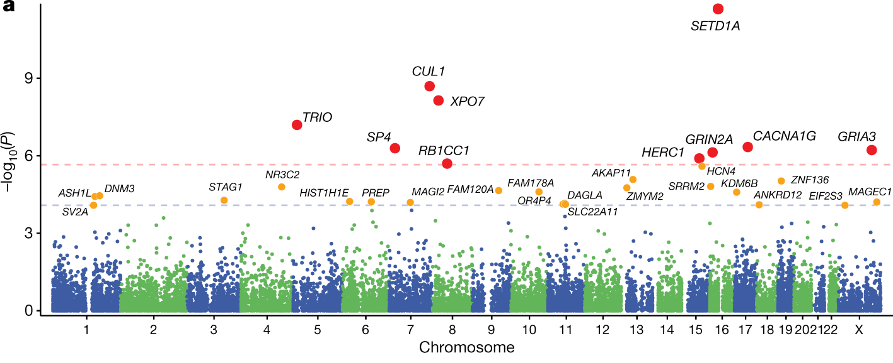
Rare coding variation is enriched in schizophrenia cases
Singh et al. (2022) Nature
Notes:
I’d like to start by highlighting the important role that rare genetic variation plays in gene discovery for neuropsychiatric diseases such as schizophrenia. It’s been previously shown in the SCHEMA exome analysis that genes reaching exome-wide significance are often some of the rarest and confer the greatest risk for schizophrenia.
For example, when we look at genes that reach exome-wide significance, such as SETD1A, XPO7, and GRIN2A
And compare the MAFs and odds ratios of protein truncating variants (or PTVs) affecting these genes, we can see that it’s the exact same ultra rare variants that have among the largest effect sizes in schizophrenia cases.
I’d like to also really emphasize that these results were produced from an exome-based analysis and that historically, there’s been a similar focus on whole exome sequencing.
However, all of this raises the question of “well, how much more could be out there, if we were to just broaden the scope of our analysis to include the whole genome? Namely, through whole genome sequencing”
these genes associated with things such as transcriptional regulation, nuclear transport, and ion transport
90% of disease associated GWAS loci discovered by assaying common variants map to noncoding regions
In humans, >4% of noncoding genome has been under purifying selection
Epigenomic studies have identified many functional noncoding elements involved in regulating gene expression underlying neurogenesis, cell differentiation, and neurodevelopment.

Slide 3
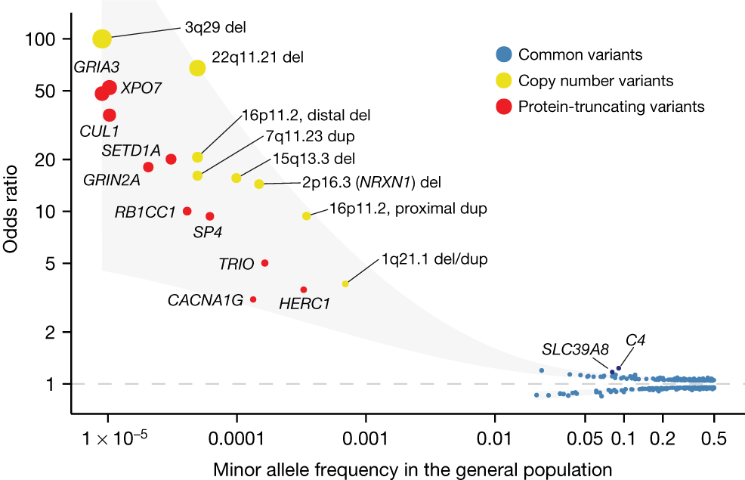
Rare coding variation is enriched in schizophrenia cases
Singh et al. (2022) Nature
Notes:
I’d like to start by highlighting the important role that rare genetic variation plays in gene discovery for neuropsychiatric diseases such as schizophrenia. It’s been previously shown in the SCHEMA exome analysis that genes reaching exome-wide significance are often some of the rarest and confer the greatest risk for schizophrenia.
For example, when we look at genes that reach exome-wide significance, such as SETD1A, XPO7, and GRIN2A
And compare the MAFs and odds ratios of protein truncating variants (or PTVs) affecting these genes, we can see that it’s the exact same ultra rare variants that have among the largest effect sizes in schizophrenia cases.
I’d like to also really emphasize that these results were produced from an exome-based analysis and that historically, there’s been a similar focus on whole exome sequencing.
However, all of this raises the question of “well, how much more could be out there, if we were to just broaden the scope of our analysis to include the whole genome? Namely, through whole genome sequencing”
these genes associated with things such as transcriptional regulation, nuclear transport, and ion transport
90% of disease associated GWAS loci discovered by assaying common variants map to noncoding regions
In humans, >4% of noncoding genome has been under purifying selection
Epigenomic studies have identified many functional noncoding elements involved in regulating gene expression underlying neurogenesis, cell differentiation, and neurodevelopment.

Slide 4
Rare coding variation is enriched in schizophrenia cases
What more can we learn from whole genome sequencing?
Singh et al. (2022) Nature
Notes:
I’d like to start by highlighting the important role that rare genetic variation plays in gene discovery for neuropsychiatric diseases such as schizophrenia. It’s been previously shown in the SCHEMA exome analysis that genes reaching exome-wide significance are often some of the rarest and confer the greatest risk for schizophrenia.
For example, when we look at genes that reach exome-wide significance, such as SETD1A, XPO7, and GRIN2A
And compare the MAFs and odds ratios of protein truncating variants (or PTVs) affecting these genes, we can see that it’s the exact same ultra rare variants that have among the largest effect sizes in schizophrenia cases.
I’d like to also really emphasize that these results were produced from an exome-based analysis and that historically, there’s been a similar focus on whole exome sequencing.
However, all of this raises the question of “well, how much more could be out there, if we were to just broaden the scope of our analysis to include the whole genome? Namely, through whole genome sequencing”
these genes associated with things such as transcriptional regulation, nuclear transport, and ion transport
90% of disease associated GWAS loci discovered by assaying common variants map to noncoding regions
In humans, >4% of noncoding genome has been under purifying selection
Epigenomic studies have identified many functional noncoding elements involved in regulating gene expression underlying neurogenesis, cell differentiation, and neurodevelopment.

Slide 5
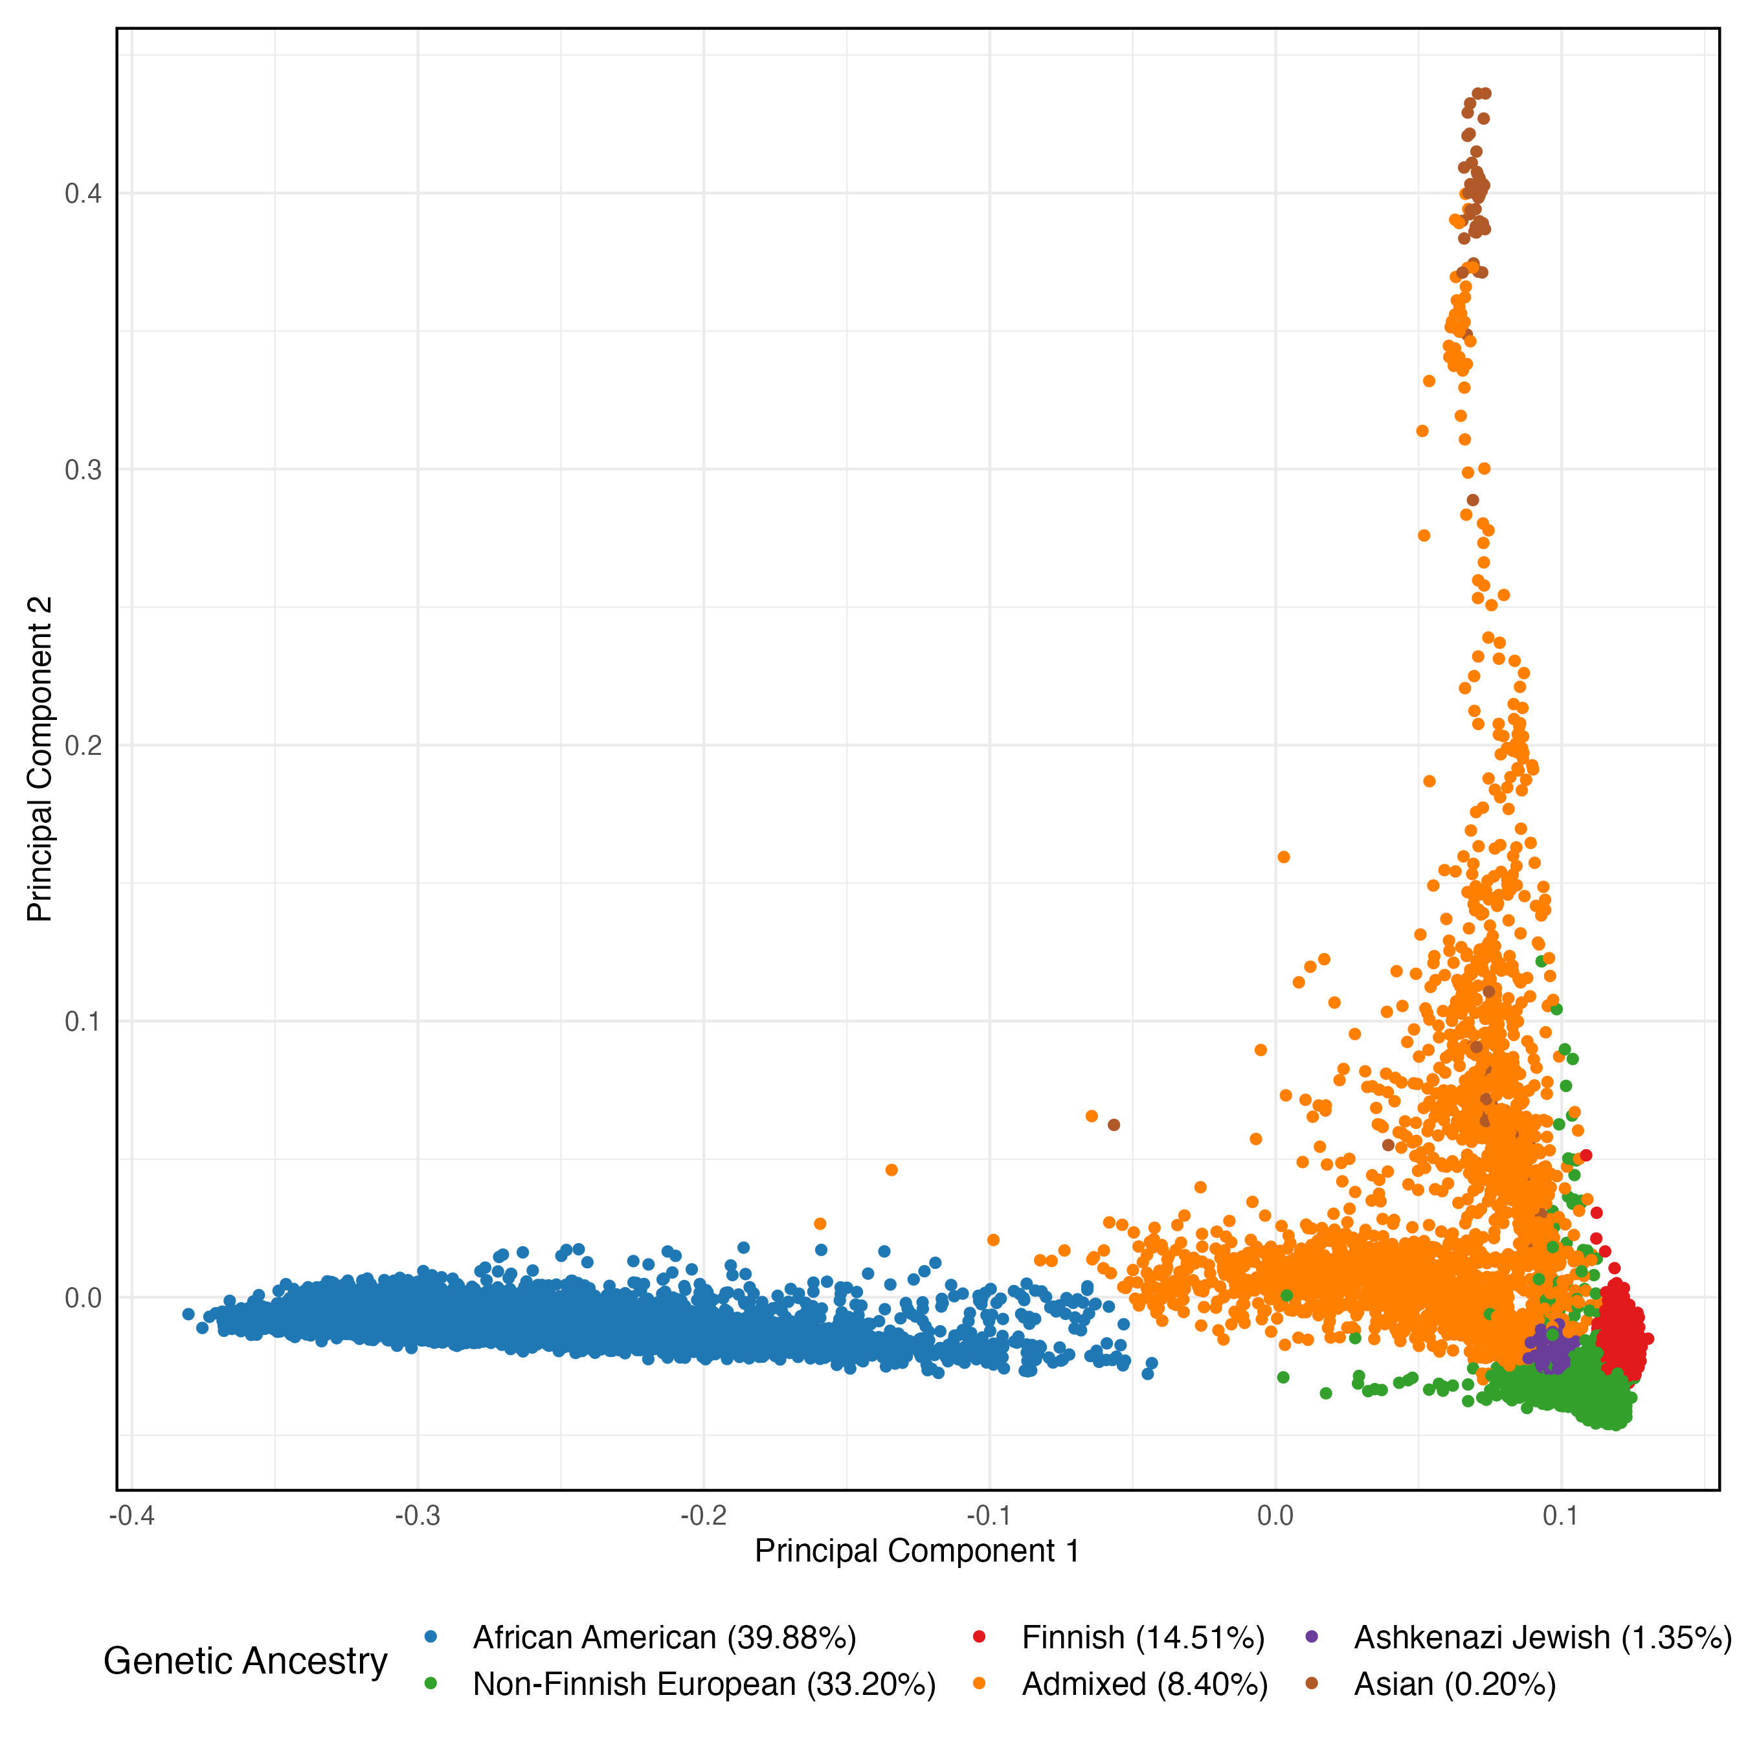
WGSPD
Schizophrenia
Bipolar Disorder
Controls
Notes:
And this is where the WGSPD consortium sits perfectly to start chipping away at this question – importantly, WGS offers better detection for single nucleotide variants, as well as for structural variation, across a much larger scope of the human genome compared to WES.
For today, we’ll be focusing on the bipolar and schizophrenia subsets of the cohort
In total, this analysis includes ~9500 cases and ~23.5k controls.
I’ll note that for all of the following analyses, the BP and SCZ samples were aggregated and analyzed together due to the known genetic overlap between the two conditions.
It’s also worth noting that the incredible diversity of this data (particularly the African American individuals) gives us the opportunity to analyze genetic ancestry groups that have been historically underrepresented in the psychgen space.
Post sample qc (filtering out poorly genotyped samples, related samples, samples with mismatching reported and imputed sex records, and samples with mismatching reported and inferred ancestry records)
For some background, the WGSPD consortium is a partnership between the National Institute of Mental Health, the Stanley Center for Psychiatric Research, as well as 11 academic institutions.

Slide 6
WGSPD
Schizophrenia (7,224)
Bipolar Disorder (2,358)
Controls (23,664)
Notes:
And this is where the WGSPD consortium sits perfectly to start chipping away at this question – importantly, WGS offers better detection for single nucleotide variants, as well as for structural variation, across a much larger scope of the human genome compared to WES.
For today, we’ll be focusing on the bipolar and schizophrenia subsets of the cohort
In total, this analysis includes ~9500 cases and ~23.5k controls.
I’ll note that for all of the following analyses, the BP and SCZ samples were aggregated and analyzed together due to the known genetic overlap between the two conditions.
It’s also worth noting that the incredible diversity of this data (particularly the African American individuals) gives us the opportunity to analyze genetic ancestry groups that have been historically underrepresented in the psychgen space.
Post sample qc (filtering out poorly genotyped samples, related samples, samples with mismatching reported and imputed sex records, and samples with mismatching reported and inferred ancestry records)
For some background, the WGSPD consortium is a partnership between the National Institute of Mental Health, the Stanley Center for Psychiatric Research, as well as 11 academic institutions.

Slide 7
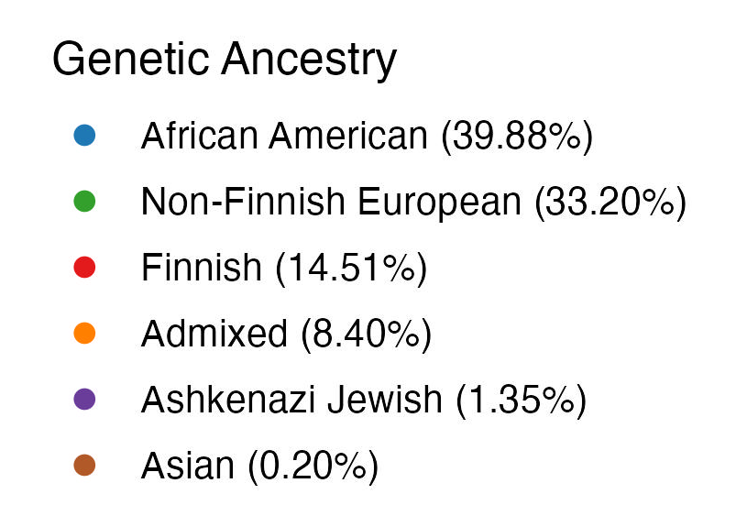
Notes:
And this is where the WGSPD consortium sits perfectly to start chipping away at this question – importantly, WGS offers better detection for single nucleotide variants, as well as for structural variation, across a much larger scope of the human genome compared to WES.
For today, we’ll be focusing on the bipolar and schizophrenia subsets of the cohort
In total, this analysis includes ~9500 cases and ~23.5k controls.
I’ll note that for all of the following analyses, the BP and SCZ samples were aggregated and analyzed together due to the known genetic overlap between the two conditions.
It’s also worth noting that the incredible diversity of this data (particularly the African American individuals) gives us the opportunity to analyze genetic ancestry groups that have been historically underrepresented in the psychgen space.
Post sample qc (filtering out poorly genotyped samples, related samples, samples with mismatching reported and imputed sex records, and samples with mismatching reported and inferred ancestry records)
For some background, the WGSPD consortium is a partnership between the National Institute of Mental Health, the Stanley Center for Psychiatric Research, as well as 11 academic institutions.

Slide 8
Gene sets in our analysis
Gene set | # genes | Source
Constrained Genes | 3570 | Karczewski et al. (2020) Nature
Schizophrenia | 32 | Singh et al. (2022) Nature
Autism Spectrum Disorder | 72 | Fu et al. (2022) Nat Genet
Neurodevelopmental Disorder | 373 | Fu et al. (2022) Nat Genet
Notes:
In order to make our results a little bit more digestible later, here are the gene sets that we used to focus and hone our analysis, all validated in separate studies.
The constrained gene set is a set of genes that were previously identified to be under strong purifying natural selection (aka constraint).
And the schizophrenia, autism spectrum, and neurodevelopmental disorder gene sets were all generated from various meta analyses of large exome consortiums.
For each of these gene sets, we look at ultra rare variation enrichment in cases compared to controls.
pLI (gnomad probability of being loss of function intolerant) metric > .9 [identified from the analysis of ~60k exomes (gnomAD)]
Bonferroni FDR significant genes [from ~24k schizophrenia cases and ~97k controls (SCHEMA)]
Bonferroni FDR significant genes [63k exomes spanning 33 autism cohort]
For each of these, we conduct a fishers exact test comparing ultra-rare counts between case and controls to arrive at an odds ratio estimate. We defined ultra rare as a MAC < 5, which corresponds to a MAF of < ~1/10%
both a way to validate and to help narrow our focus to regions and genes of interest WRT our cohort.

Slide 9
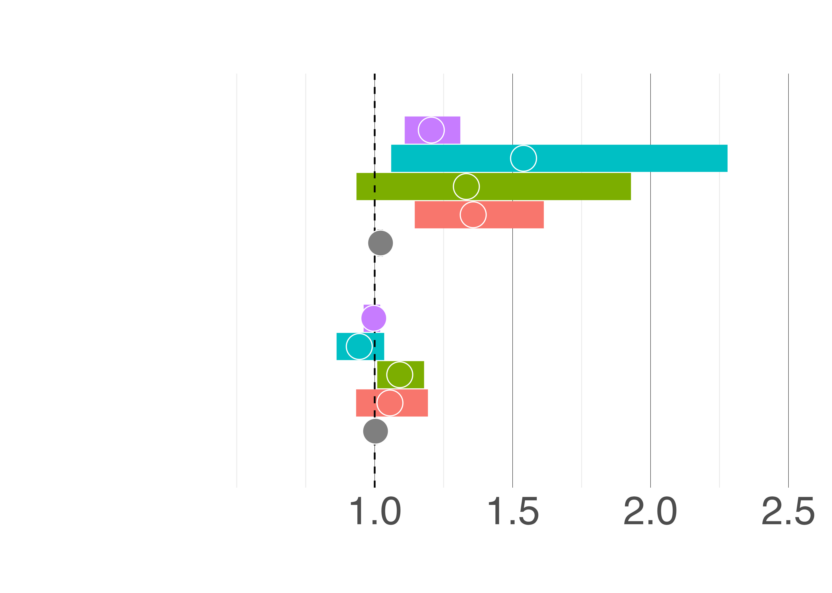
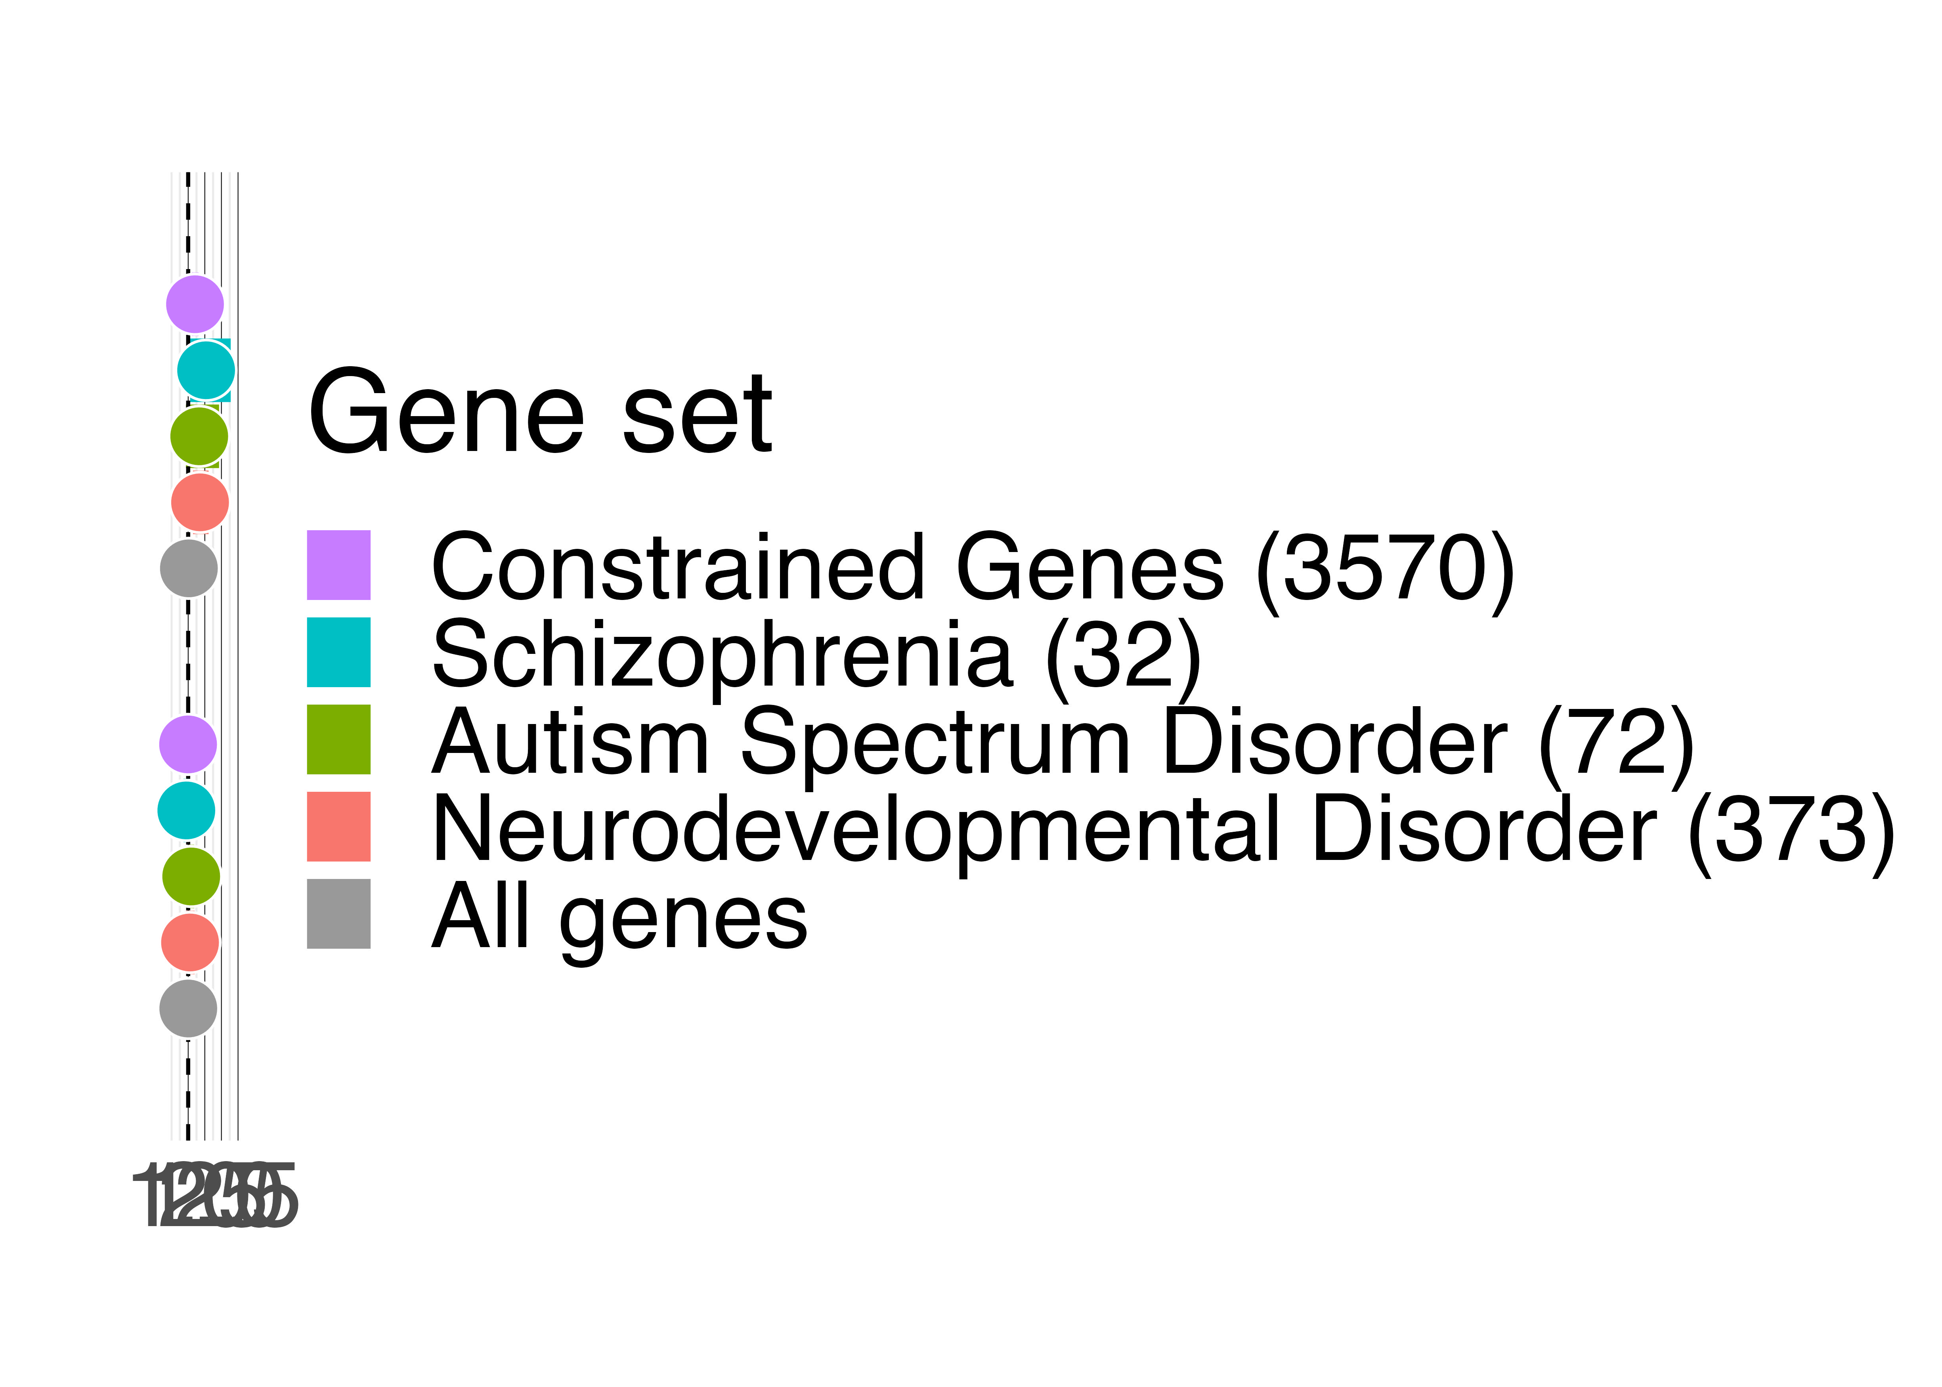
SNVs
Protein Truncating Variants (PTVs)
1.20
1.53
There is an expected enrichment of ultra-rare protein truncating variants (PTVs) in constrained and neuropsychiatric genes
1.33
1.35
1.02
Odds ratio (95% CI)
Notes:
The first thing that we looked at were ultra rare, coding single nucleotide variants (SNVs).
And what we saw was an expected enrichment across the board of protein truncating variants (or PTVs) within each of our gene sets of interest.
And this serves as a really great and encouraging positive control, since we’re reaffirming that we can detect the same sort of effects through genome analysis as we’ve seen before in exome analysis.
Stepping through each of the results,
On the right, we’re plotting odds ratio estimates and corresponding 95% confidence intervals
Going one-by-one, we see an enrichment of PTVs disrupting genes that are under constraint (in purple), with an OR estimate of 1.2.
Similarly, we see an even greater effect in genes associated with schizophrenia (in blue) with an OR estimate of about 1.5. And this larger effect is most likely due to the specificity of schizophrenia genes in our (largely) schizophrenia affected cohort.
The remaining autism (in green) and neurodevelopmental (in red) gene sets also show a slightly larger effect compared to constrained genes (of about 1.3 for both) likely due to the genetic overlap between these conditions and our cohort phenotypes.
Lastly, we’ve also included an additional baseline metric that looks at all genes that were detected (in grey), and this is expected to be something close to 1, which is exactly what we see.
PTVs predicted using ensemble’s variant effect predictor VEP
seem fairly well calibrated at this point, and the variation that we see should get better as we increase sample size
After all, synonymous variation isn’t expected to have much effect (if any) on gene expression, so it wouldn’t make sense to see any significant enrichment like we do for PTVs.

Slide 10
SNVs
Protein Truncating Variants (PTVs)
1.20
1.53
1.33
There is an expected lack of enrichment of ultra-rare synonymous variants in constrained and neuropsychiatric genes
1.35
1.02
0.99
Synonymous Variants
0.94
1.09
1.05
1.00
Odds ratio (95% CI)
Notes:
Next, we took a similar look at synonymous variation with respect to these gene sets as a sort of negative control
This time, we’re seeing almost no enrichment with all OR estimates hovering at around 1 and this is all within reason for our expectations.
And so now that we have confirmation that we’re well established and well calibrated for signal in the coding regions, we can turn our attention to the noncoding regions that, once again, we haven’t been able to interrogate using just whole exome sequencing.
PTVs predicted using ensemble’s variant effect predictor VEP
seem fairly well calibrated at this point, and the variation that we see should get better as we increase sample size
After all, synonymous variation isn’t expected to have much effect (if any) on gene expression, so it wouldn’t make sense to see any significant enrichment like we do for PTVs.

Slide 11
SNVs
Protein Truncating Variants (PTVs)
1.20
1.53
1.33
There is an expected lack of enrichment of ultra-rare synonymous variants in constrained and neuropsychiatric genes
1.35
1.02
What about noncoding regions?
0.99
Synonymous Variants
0.94
1.09
1.05
1.00
Odds ratio (95% CI)
Notes:
Next, we took a similar look at synonymous variation with respect to these gene sets as a sort of negative control
This time, we’re seeing almost no enrichment with all OR estimates hovering at around 1 and this is all within reason for our expectations.
And so now that we have confirmation that we’re well established and well calibrated for signal in the coding regions, we can turn our attention to the noncoding regions that, once again, we haven’t been able to interrogate using just whole exome sequencing.
PTVs predicted using ensemble’s variant effect predictor VEP
seem fairly well calibrated at this point, and the variation that we see should get better as we increase sample size
After all, synonymous variation isn’t expected to have much effect (if any) on gene expression, so it wouldn’t make sense to see any significant enrichment like we do for PTVs.

Slide 12
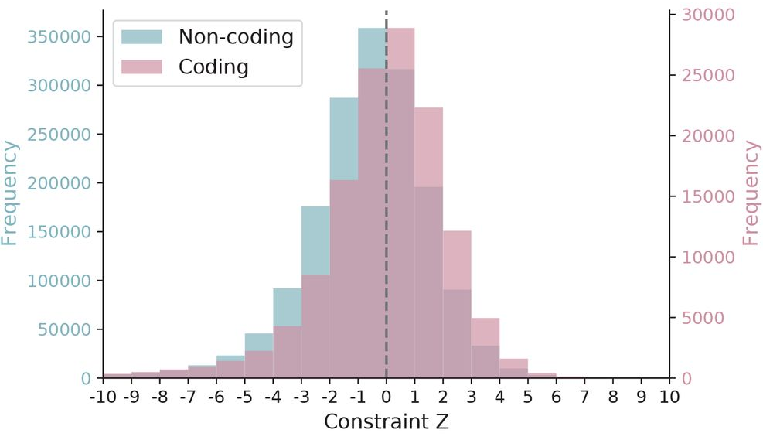
Noncoding constraint focuses the scope of our analysis
Chen et al. (2022) preprint
Notes:
Similar to the previous notion of constrained coding regions that we’ve known for a while how to confidently determine and interpret, what we’re seeing here is a new metric developed by Siwei Chen that similarly quantifies constraint in noncoding genomic regions, and what’s really exciting about this is that it lets us start asking similar questions about the noncoding space as we have been with the coding genome.
And specifically, what we’re going to be interested in looking at, are the most constrained, most informative noncoding regions (in blue) with Z scores > 4 to see what kind of signal we can start picking up on among cases and controls.
These highly constrained noncoding regions fall within these buckets, and correspond to about the 99th percentile of constraint.
through which we can identify protein-coding genes that are under
purifying natural selection,
And the general idea here is that, while we have a nicely annotated “roadmap” (in a sense) for the coding regions, right now the noncoding space

Slide 13
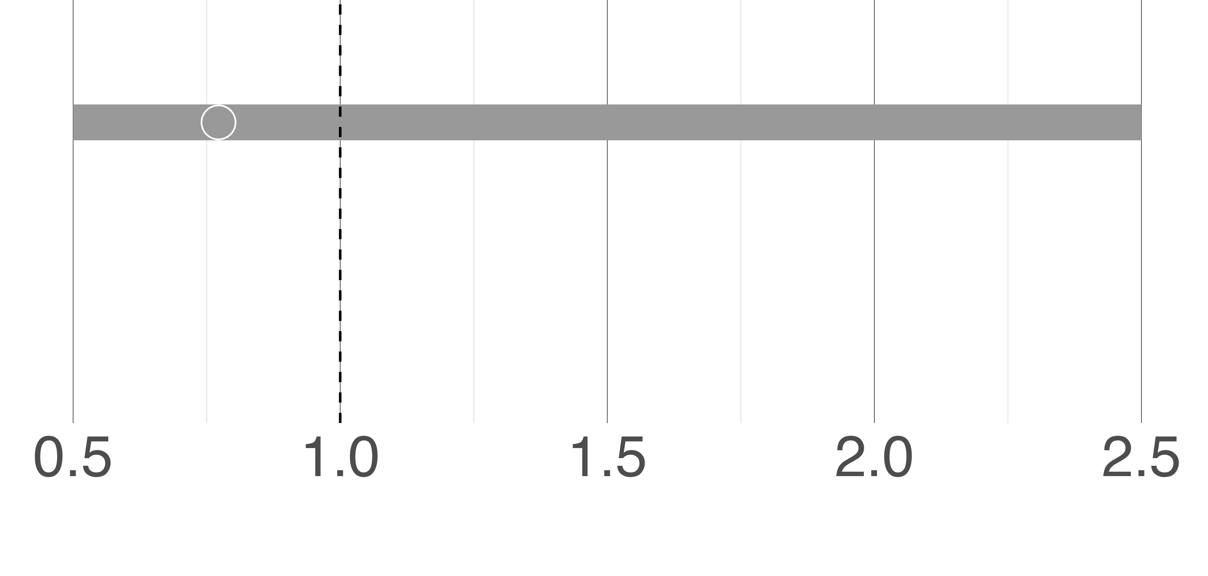
Noncoding Constrained Regions
There is no significant enrichment of ultra-rare single nucleotide variation (SNV) in noncoding constrained regions…
SNV
0.77
Odds ratio (95% CI)
Notes:
Unfortunately this time, we don’t find any significant positive enrichment. With an odds ratio of around .77, and we also have a pretty wide confidence interval.
These results are consistent with a similar, separate analysis on an epilepsy cohort, and we would likely need a much larger number of samples to start detecting our expected positive signal in these regions.
And while SNVs haven’t shown themselves to be the best window into the noncoding regions at this point due to a lack of power, (and I’m about to give away my real punchline here) there’s a stark difference when we look at structural variation using the same set of noncoding constrained regions.
Specifically, there’s a strong positive enrichment in our cases when we look at large deletion and duplication events spanning these constrained noncoding intervals. Rather than just point mutations within these intervals.
And again, these are the 99th percentile of constrained regions and we can see that the odds ratios of these two events are much higher with much tighter confidence bounds around 2, compared to the weaker effect that we see in SNVs.
And I really want to linger on this comparison and once again bring attention to this difference that we’re seeing. Unlike in the coding space, the effects of single nucleotide events are much harder to characterize in noncoding regions. On the other hand, larger structural perturbations (like these deletions spanning entire regions) could be more informative and provide greater insight, despite being rarer.
And this is the basic rationale for why we shifted away from single nucleotide variation. And instead consider structural variation in this next section.
Afterall, how do you differentiate a “synonymous-like” and a “protein-truncating-like” point mutation in the noncoding space? Before, we were able to accurately throw out synonymous variation from our analysis and saw an expected enrichment signal within our cases. But there’s no notion of that in the noncoding space yet, so we would have to rely on much larger cohort sizes.
Filtered to 19471 intervals (1kb in size each), z >4 corresponding to ~99th percentile of all noncoding 1kb intervals
Bc we don’t know what’s happening in snvs, harder to id signal (can’t remove synonymous-like SNVs, or SNVs that don’t result in any change of expression)
In coding region, we can partition into ptv, mis, syn

Slide 14
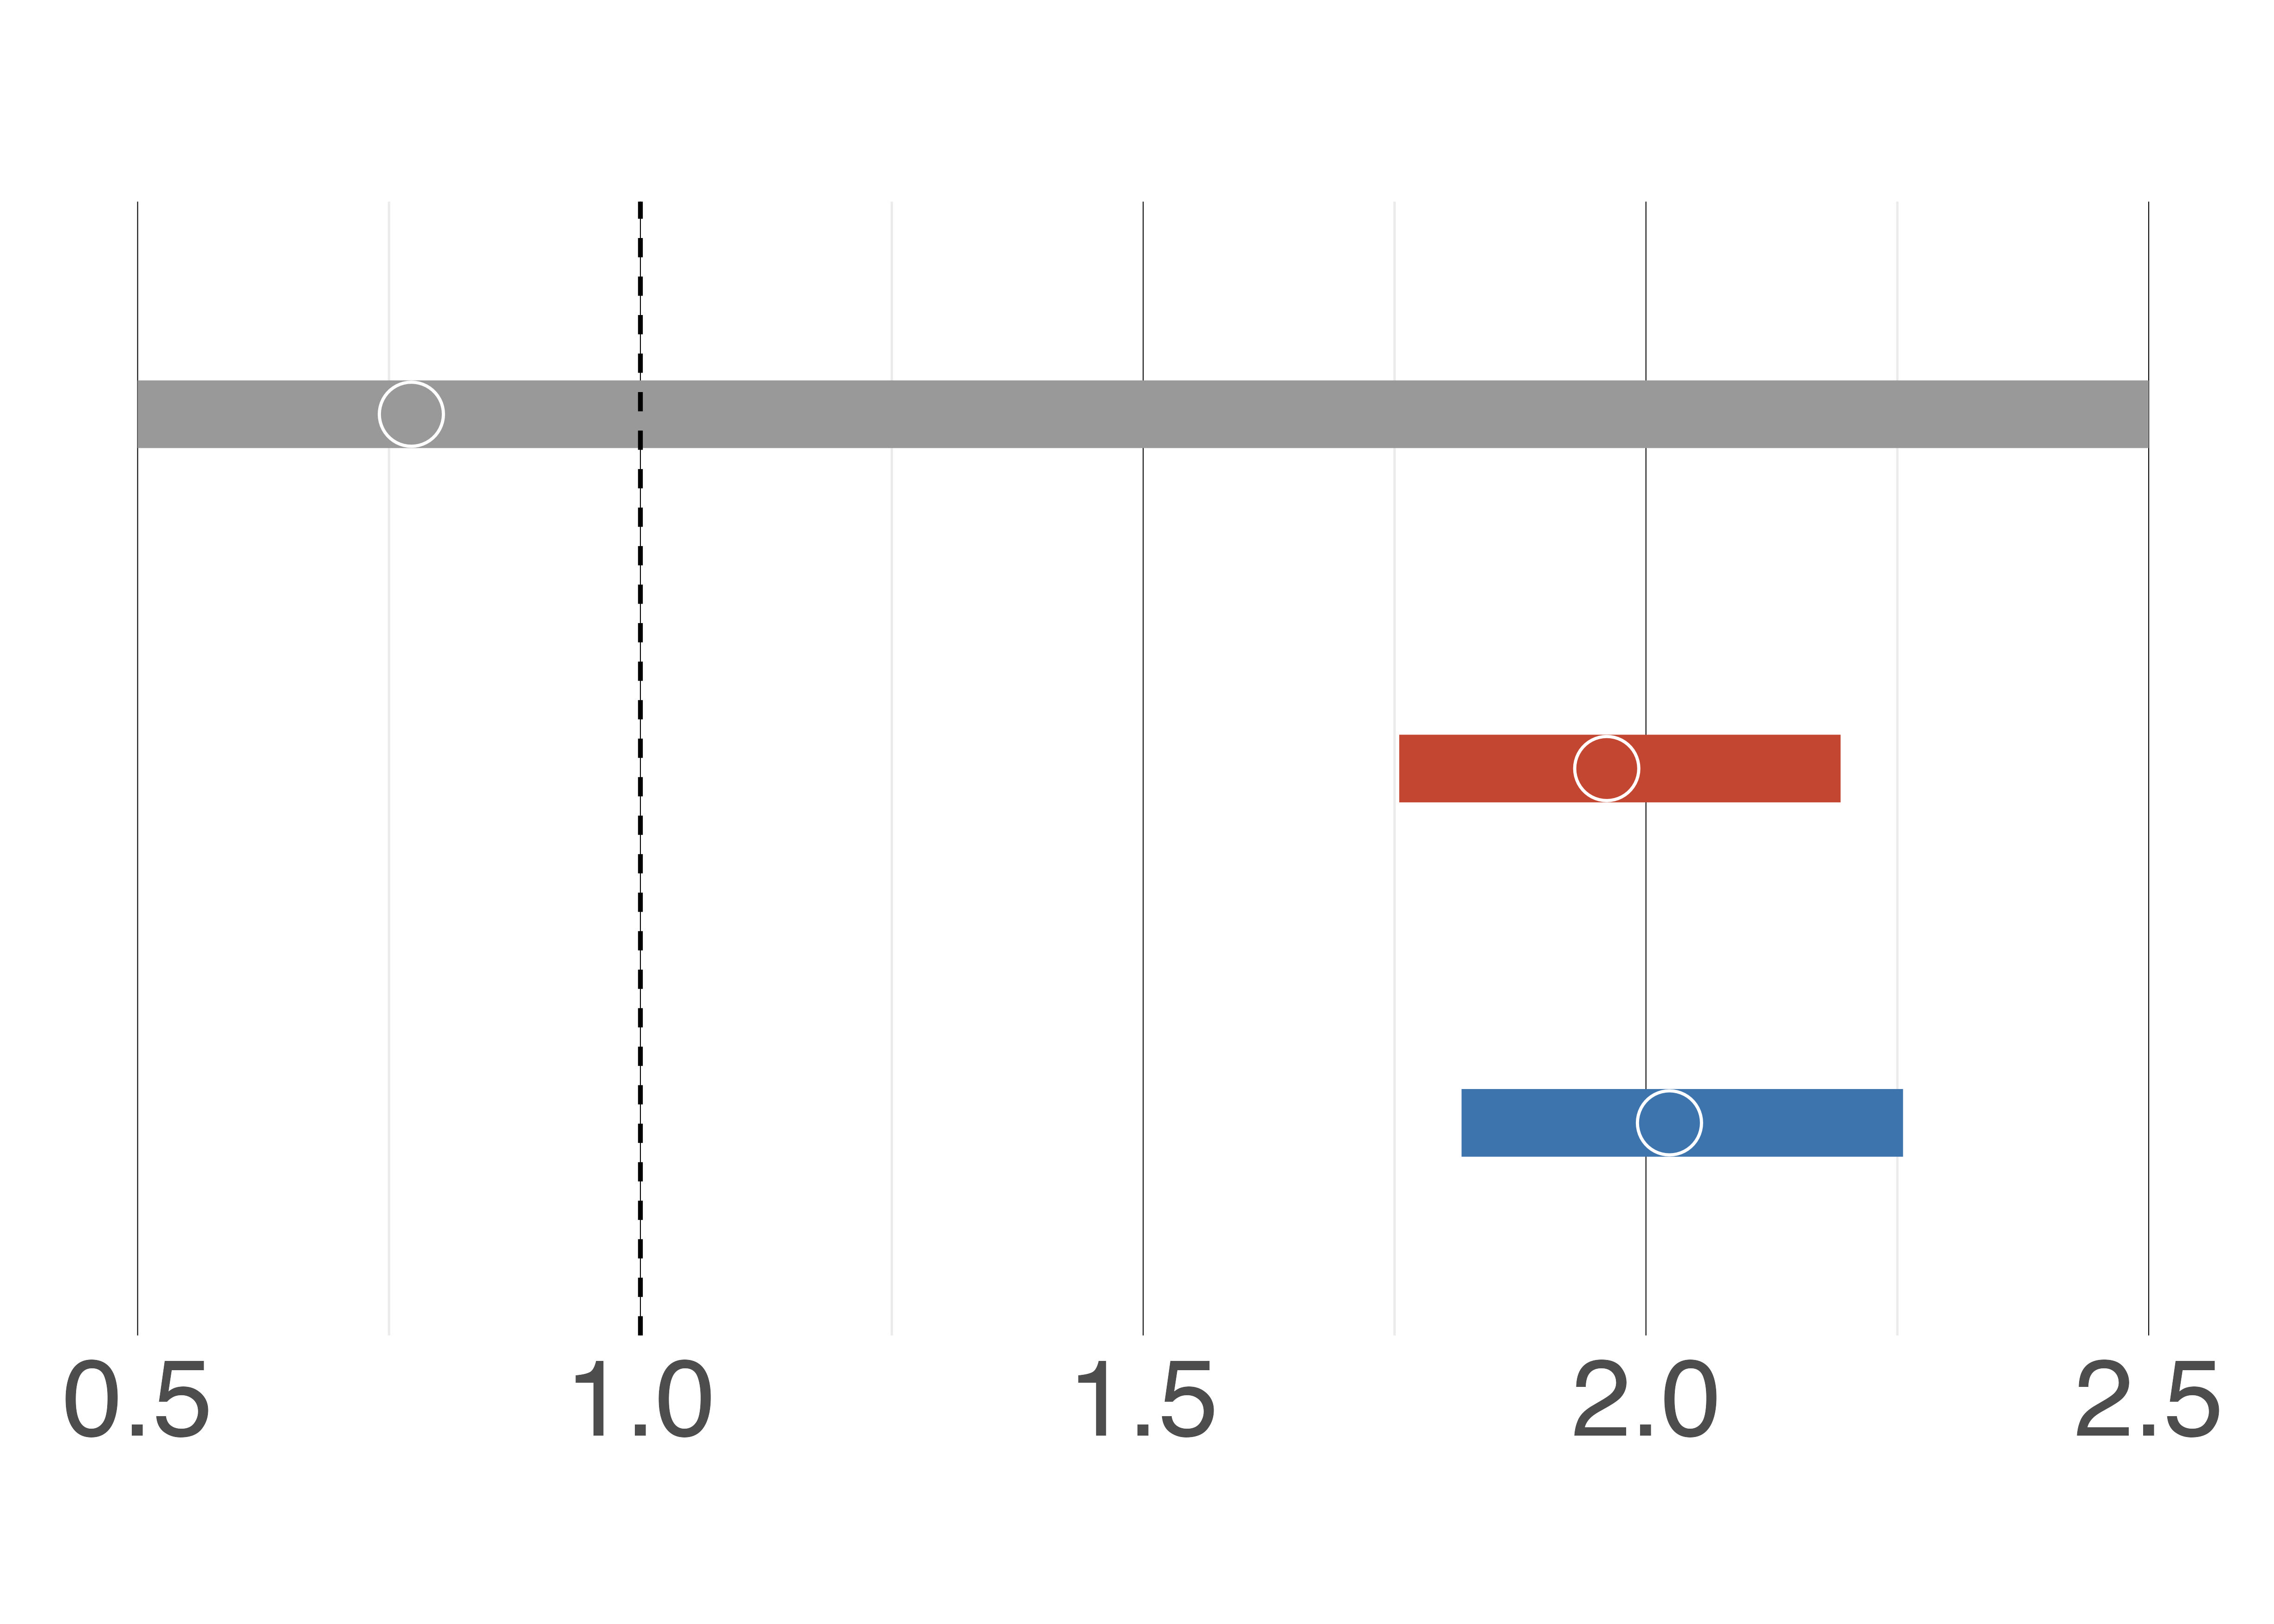
Noncoding Constrained Regions
However, there is a significant enrichment of ultra-rare deletion and duplication structural variation (SV) in noncoding constrained regions
SNV
0.77
Deletion
SV
1.96
Duplication
SV
2.02
Odds ratio (95% CI)
Notes:
Unfortunately this time, we don’t find any significant positive enrichment. With an odds ratio of around .77, and we also have a pretty wide confidence interval.
These results are consistent with a similar, separate analysis on an epilepsy cohort, and we would likely need a much larger number of samples to start detecting our expected positive signal in these regions.
And while SNVs haven’t shown themselves to be the best window into the noncoding regions at this point due to a lack of power, (and I’m about to give away my real punchline here) there’s a stark difference when we look at structural variation using the same set of noncoding constrained regions.
Specifically, there’s a strong positive enrichment in our cases when we look at large deletion and duplication events spanning these constrained noncoding intervals. Rather than just point mutations within these intervals.
And again, these are the 99th percentile of constrained regions and we can see that the odds ratios of these two events are much higher with much tighter confidence bounds around 2, compared to the weaker effect that we see in SNVs.
And I really want to linger on this comparison and once again bring attention to this difference that we’re seeing. Unlike in the coding space, the effects of single nucleotide events are much harder to characterize in noncoding regions. On the other hand, larger structural perturbations (like these deletions spanning entire regions) could be more informative and provide greater insight, despite being rarer.
And this is the basic rationale for why we shifted away from single nucleotide variation. And instead consider structural variation in this next section.
Afterall, how do you differentiate a “synonymous-like” and a “protein-truncating-like” point mutation in the noncoding space? Before, we were able to accurately throw out synonymous variation from our analysis and saw an expected enrichment signal within our cases. But there’s no notion of that in the noncoding space yet, so we would have to rely on much larger cohort sizes.
Filtered to 19471 intervals (1kb in size each), z >4 corresponding to ~99th percentile of all noncoding 1kb intervals
Bc we don’t know what’s happening in snvs, harder to id signal (can’t remove synonymous-like SNVs, or SNVs that don’t result in any change of expression)
In coding region, we can partition into ptv, mis, syn

Slide 15
Noncoding Constrained Regions
However, there is a significant enrichment of ultra-rare deletion and duplication structural variation (SV) in noncoding constrained regions
SNV
0.77
Let’s focus on structural variation instead
Deletion
SV
1.96
Duplication
SV
2.02
Odds ratio (95% CI)
Notes:
Unfortunately this time, we don’t find any significant positive enrichment. With an odds ratio of around .77, and we also have a pretty wide confidence interval.
These results are consistent with a similar, separate analysis on an epilepsy cohort, and we would likely need a much larger number of samples to start detecting our expected positive signal in these regions.
And while SNVs haven’t shown themselves to be the best window into the noncoding regions at this point due to a lack of power, (and I’m about to give away my real punchline here) there’s a stark difference when we look at structural variation using the same set of noncoding constrained regions.
Specifically, there’s a strong positive enrichment in our cases when we look at large deletion and duplication events spanning these constrained noncoding intervals. Rather than just point mutations within these intervals.
And again, these are the 99th percentile of constrained regions and we can see that the odds ratios of these two events are much higher with much tighter confidence bounds around 2, compared to the weaker effect that we see in SNVs.
And I really want to linger on this comparison and once again bring attention to this difference that we’re seeing. Unlike in the coding space, the effects of single nucleotide events are much harder to characterize in noncoding regions. On the other hand, larger structural perturbations (like these deletions spanning entire regions) could be more informative and provide greater insight, despite being rarer.
And this is the basic rationale for why we shifted away from single nucleotide variation. And instead consider structural variation in this next section.
Afterall, how do you differentiate a “synonymous-like” and a “protein-truncating-like” point mutation in the noncoding space? Before, we were able to accurately throw out synonymous variation from our analysis and saw an expected enrichment signal within our cases. But there’s no notion of that in the noncoding space yet, so we would have to rely on much larger cohort sizes.
Filtered to 19471 intervals (1kb in size each), z >4 corresponding to ~99th percentile of all noncoding 1kb intervals
Bc we don’t know what’s happening in snvs, harder to id signal (can’t remove synonymous-like SNVs, or SNVs that don’t result in any change of expression)
In coding region, we can partition into ptv, mis, syn

Slide 16
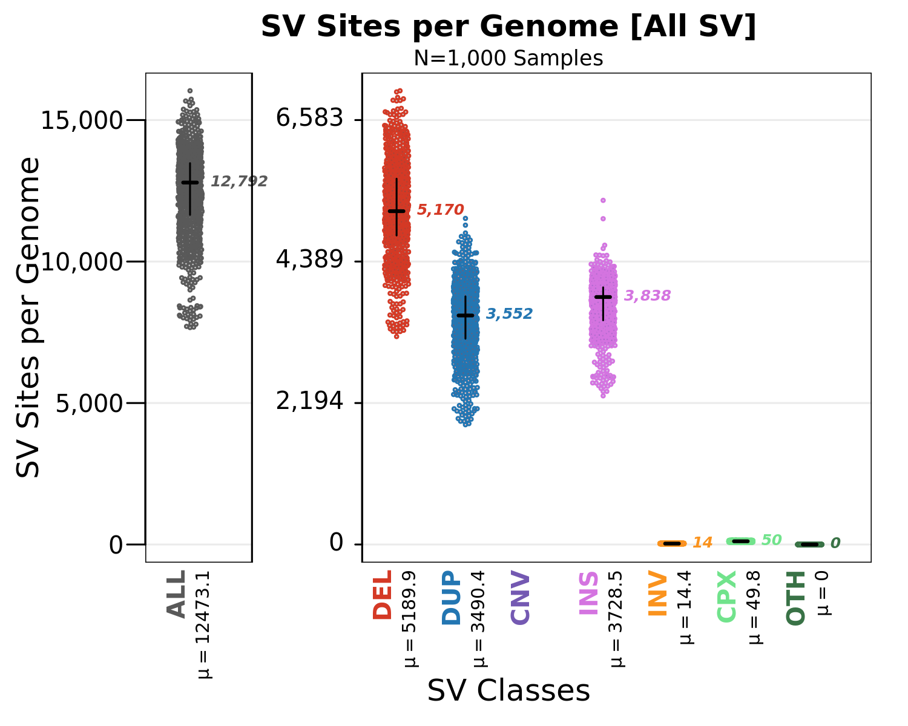
Deletion events are well-characterized in WGSPD
Notes:
Before diving into the analysis, here’s a summary of the quantity of each SV being called per sample. Because of the abundance and interpretability of deletions, our preliminary analysis moving forward will focus on those.
and, while we do seem to have a very high number of duplication and insertion events per sample, their interpretability is much more annotation dependent, so

Slide 17
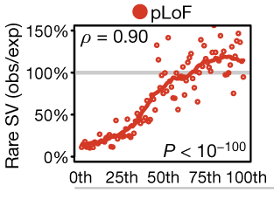
There is a strong concordance between rare deletion SVs and existing SNV constraint metrics.
pLoF SNV constraint (LOEUF) percentile
Collins et al. (2020) Nature
Notes:
One thing that I want to quickly highlight and provide some more motivation for, that we’ll see in the upcoming results, is our continued interest in and use of the constrained gene set while looking at SVs
In particular, we’re expecting and hoping to see a concordance between rare deletion SVs and constraint, which is really motivated by the previous work summarized in this plot.
What we’re seeing is that among the most constrained genes (towards the left side of the plot), we see a pretty clear depletion of deletions compared to what we see in some of the less constrained genes (on the right side of the plot).
Expectation of deletions based on gene length, genomic context, and structure of exons and introns

Slide 18
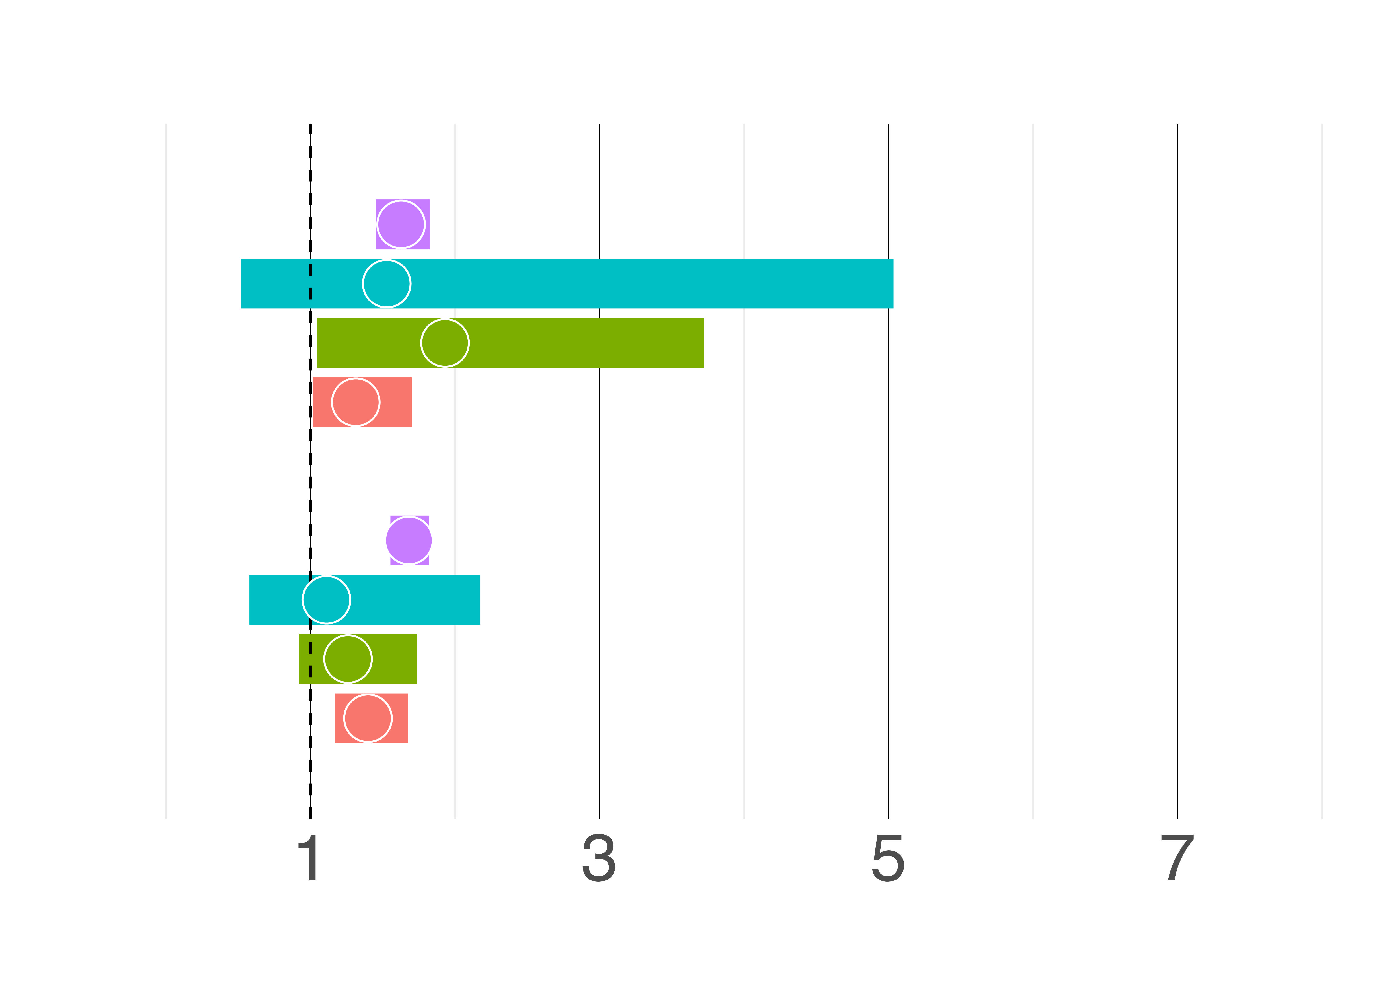
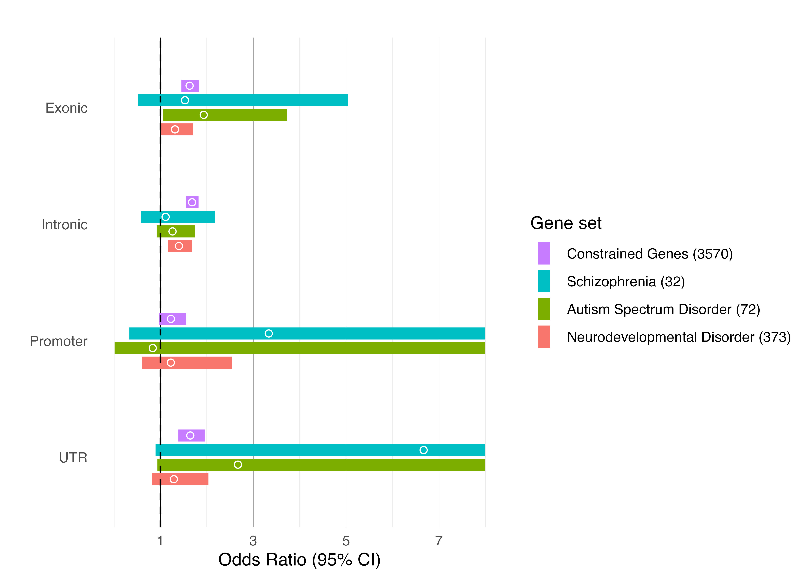
Deletion SVs
1.62
1.52
Exonic
1.93
1.31
Deletion SVs recapitulate exonic SNV enrichment and detect additional intronic enrichment
1.68
1.11
Intronic
1.25
1.39
Odds ratio (95% CI)
Notes:
And so, now we can start diving into deletion SV events, using all of our favorite gene sets from before. //
For exonic events, which are simply deletions that have any overlap with an exon, we see enrichment across the board, all of which are comparable to what we’ve just seen within the coding space with protein truncating variants.
Once again, we see a nice enrichment in constrained genes that mimics what we saw with SNVs of around 1.6 (in purple), in line with our expectations.
And a similar enrichment as with PTVs across schizophrenia, autism, and neurodevelopmental gene sets.
Once again, these serve as an excellent positive control and we’re seeing signal exactly where we would expect.
However, improving upon and going beyond coding SNV analysis, we’re starting to pick up on this additional intronic signal, which gives us confidence in the viability of using SVs for this kind of analysis that goes beyond the coding space.
Here, we’re considering deletion SV events that only span intronic regions and once again we’re able to see a similar, general pattern of enrichment.
Once again, I want to draw special attention to the constrained gene signal (in purple) tha has an OR hovering above 1.6

Slide 19
Deletion SVs
1.62
1.52
Exonic
1.93
1.31
Deletion SVs recapitulate exonic SNV enrichment and detect additional intronic enrichment
1.68
1.11
Intronic
1.25
1.39
Odds ratio (95% CI)
Notes:
And so, now we can start diving into deletion SV events, using all of our favorite gene sets from before. //
For exonic events, which are simply deletions that have any overlap with an exon, we see enrichment across the board, all of which are comparable to what we’ve just seen within the coding space with protein truncating variants.
Once again, we see a nice enrichment in constrained genes that mimics what we saw with SNVs of around 1.6 (in purple), in line with our expectations.
And a similar enrichment as with PTVs across schizophrenia, autism, and neurodevelopmental gene sets.
Once again, these serve as an excellent positive control and we’re seeing signal exactly where we would expect.
However, improving upon and going beyond coding SNV analysis, we’re starting to pick up on this additional intronic signal, which gives us confidence in the viability of using SVs for this kind of analysis that goes beyond the coding space.
Here, we’re considering deletion SV events that only span intronic regions and once again we’re able to see a similar, general pattern of enrichment.
Once again, I want to draw special attention to the constrained gene signal (in purple) tha has an OR hovering above 1.6

Slide 20
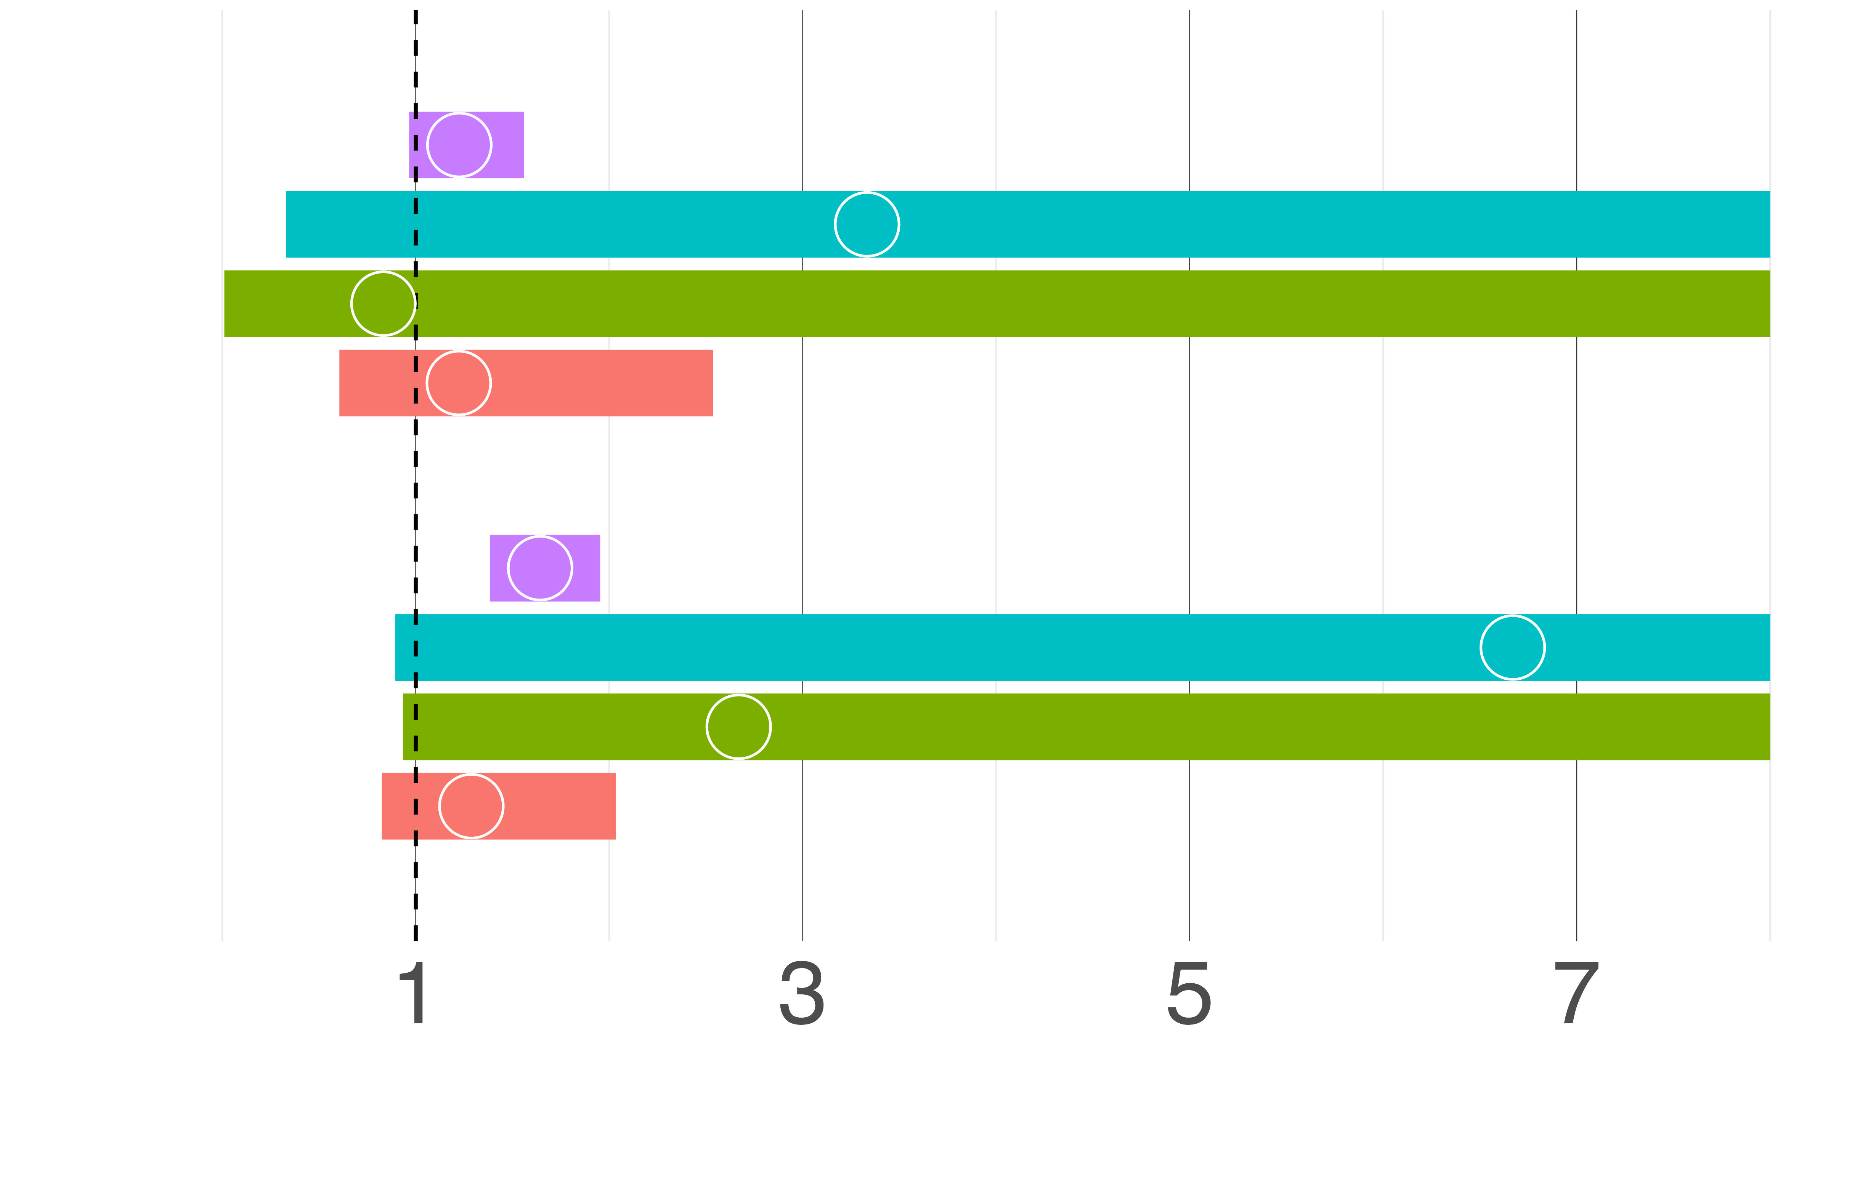
Deletion SVs
1.22
Promoter
3.33
Deletion SVs affecting promoter and 5’ UTR regions show a strong positive enrichment in constrained genes and schizophrenia-associated genes
0.83
1.22
1.64
6.66
5’ UTR
2.66
1.28
Odds ratio (95% CI)
Notes:
Lastly, we’re also able to interrogate promoter and 5’ UTR regions using SVs.
Specifically, we’re considering deletions that have any overlap with a promoter and a 5’ UTR region
We chose to focus on these regions, since the entire noncoding space is difficult to understand, and these regions seem to be a sensible, interpretable place to start.
Once again, we’re able to see a strong positive enrichment in constrained genes, as expected for these rare deletions (hovering around 1.2 and 1.6, respectively)
But what I think is more interesting here is the significantly stronger point estimates for SCZ associated genes in both categories (of around 3.3 and 6.6).
This seems to indicate that noncoding structural variation, particularly those affecting promoter and UTR regions, could be a useful indicator for teasing out which genes are important for SCZ risk.
Running with this idea, it might be reasonable to incorporate SVs to help improve gene discovery.
[which could in turn disrupt the TSS or a have a similar effect on the promoter inhibiting transcription]]

Slide 21
Deletion SVs
1.22
Promoter
3.33
Deletion SVs affecting promoter and 5’ UTR regions show a strong positive enrichment in constrained genes and schizophrenia-associated genes
0.83
1.22
1.64
6.66
5’ UTR
2.66
1.28
Odds ratio (95% CI)
Notes:
Lastly, we’re also able to interrogate promoter and 5’ UTR regions using SVs.
Specifically, we’re considering deletions that have any overlap with a promoter and a 5’ UTR region
We chose to focus on these regions, since the entire noncoding space is difficult to understand, and these regions seem to be a sensible, interpretable place to start.
Once again, we’re able to see a strong positive enrichment in constrained genes, as expected for these rare deletions (hovering around 1.2 and 1.6, respectively)
But what I think is more interesting here is the significantly stronger point estimates for SCZ associated genes in both categories (of around 3.3 and 6.6).
This seems to indicate that noncoding structural variation, particularly those affecting promoter and UTR regions, could be a useful indicator for teasing out which genes are important for SCZ risk.
Running with this idea, it might be reasonable to incorporate SVs to help improve gene discovery.
[which could in turn disrupt the TSS or a have a similar effect on the promoter inhibiting transcription]]

Slide 22
Deletion SVs
1.22
Promoter
3.33
Deletion SVs affecting promoter and 5’ UTR regions show a strong positive enrichment in constrained genes and schizophrenia-associated genes
0.83
1.22
1.64
Incorporating SVs may help improve gene discovery
6.66
5’ UTR
2.66
1.28
Odds ratio (95% CI)
Notes:
Lastly, we’re also able to interrogate promoter and 5’ UTR regions using SVs.
Specifically, we’re considering deletions that have any overlap with a promoter and a 5’ UTR region
We chose to focus on these regions, since the entire noncoding space is difficult to understand, and these regions seem to be a sensible, interpretable place to start.
Once again, we’re able to see a strong positive enrichment in constrained genes, as expected for these rare deletions (hovering around 1.2 and 1.6, respectively)
But what I think is more interesting here is the significantly stronger point estimates for SCZ associated genes in both categories (of around 3.3 and 6.6).
This seems to indicate that noncoding structural variation, particularly those affecting promoter and UTR regions, could be a useful indicator for teasing out which genes are important for SCZ risk.
Running with this idea, it might be reasonable to incorporate SVs to help improve gene discovery.
[which could in turn disrupt the TSS or a have a similar effect on the promoter inhibiting transcription]]

Slide 23
Genes affected by 5’ UTR deletions are among previously identified, significant schizophrenia-associated genes
SRRM2 ANKRD12
KDM6B EIF2S3
MAGI2
Notes:
As a simple proof of concept, and to make this idea a little bit more concrete, we find these 5 genes in our dataset that are affected by ultra rare UTR deletions.
Comparing these to the previous SCHEMA analysis of schizophrenia exomes, we find that these genes are also among those determined to be bonferoni FDR significant.
However, had these 5’ UTR deletions been added to the previous SCHEMA exome analysis, these genes could have been pushed up and reclassified to exome wide significance.

Slide 24
Noncoding Constrained Regions
There is no significant enrichment of SNVs, but significant enrichment of SVs in noncoding constrained regions
SNV
0.77
Deletion
SV
1.96
Duplication
SV
2.02
Odds ratio (95% CI)
Notes:
Finally, I just wanted to bring back this result that I originally used to motivate the value of using ultra rare SVs over SNVs, particularly when we want to look at noncoding signal, and tie everything together to highlight the direction that we’re hoping to continue building toward.
I think that this result really encapsulates and tells a story of how important SVs are and, in the larger picture, how important WGS is.
Whereas SNVs weren’t able to detect any clear positive enrichment of constraint in noncoding regions, deletion and duplication SVs show a very different picture – with these point estimates hovering around 2.
Of course, we’re only able to appreciate this result because of the resolution and scope of WGS when it comes to detecting these types of events
And of course, I’ve only briefly teased this noncoding duplication signal, but there’s certainly a lot more to be uncovered from really refining and digging into these duplication events.

Slide 25
Conclusions
Noncoding SNVs are not as biologically interpretable
SVs can help identify noncoding constrained regions associated with neuropsychiatric disorders
SVs affecting noncoding regions, such as the promoter and UTR, may contribute towards disease risk
Incorporating SVs may help improve gene discovery
Notes:
So, final takeaways.
We’ve shown that noncoding SNVs are far less biologically interpretable compared to SVs
In particular, SVs can be used to help identify noncoding constrained regions associated with neuropsychiatric disorders
And in this case, we’ve shown an example in which SVs affecting promoters and UTRs could contribute towards schizophrenia risk
All in all, we’ve made a case for the integration and the benefits of SVs in gene discovery

Slide 26

Acknowledgements
Stanley Center:
Benjamin Neale
Mike Talkowski
Mark Daly
Cal Liao
Jack Fu
Chelsea Lowther
Xuefang Zhao
Dan Howrigan
Sinéad Chapman
Caroline Cusick
Sam Bryant
WGSPD consortium collaborators:
Michael Boehnke – University of Michigan
Nelson Freimer – University of California, Los Angeles
Stacey Gabriel – Broad Institute of MIT and Harvard
Sarah Gagliano – University of Michigan
Guilio Genovese – Broad Institute of MIT and Harvard
David Glahn – Boston Children’s Hospital
Hyun Min Kang – University of Michigan
James Knowles – SUNY Downstate Medical Center
Steven McCarroll – Harvard University
Roel Ophoff – University of California, Los Angeles
Aarno Palotie – University of Helsinki
Duncan Palmer – Broad Institute of MIT and Harvard
Carlos Pato – SUNY Downstate Medical Center
Michele Pato – SUNY Downstate Medical Center
Laura Scott – University of Michigan
Contact info:
rye@broadinstitute.org
Notes:
Lastly, I'd like to give a huge thank you to Cal, Ben, and Mike for their mentorship. As well as to all of the collaborators and folks involved with the WGSPD consortium. and of course, all of you for your attention. Thank you.

Slide 27
Types of genetic variation reliably detected by genomic technologies
Karyotype (≤ 1% common; ≤ 1% rare): Chromosomal aneuploidies, massive structural variation (for example, translocations, inversions, CNVs of millions of nucleotides), and some fragile sites with special protocols. Microarray (~90% common; ~1% rare): Protein coding and noncoding common SNVs and large, rare CNVs (over ~20,000 nucleotides). Exome sequencing (~1% common; ~1% rare): Protein coding common SNVs and indels, protein coding rare SNVs and indels, and some CNVs. Low-coverage WGS (~95% common; ~85% rare): Protein coding and noncoding common SNVs, and most protein coding and noncoding rare SNVs. Deep-coverage WGS (~99% common; ~99% rare): Protein coding and noncoding common SNVs and indels, protein coding and noncoding rare SNVs and indels, rare and common CNVs (over ~1,000 nucleotides), multi-allelic CNVs (for example, over three copies), mobile element insertions, and other structural variation (for example, translocations, inversions). Long-read (>10,000 bp), deep-coverage WGS (~100% common; ~100% rare): For deep-coverage WGS plus: small CNVs (50–1,000 nucleotides), complex structural variation, variants in repetitive DNA, and direct assessment of phasing (whether two variants are on the same allele).
Sanders, S.J., Neale, B.M., Huang, H. et al. (2017) Nat Neurosci

Slide 28
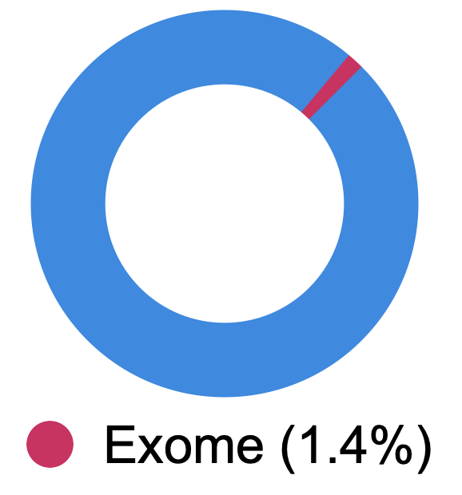
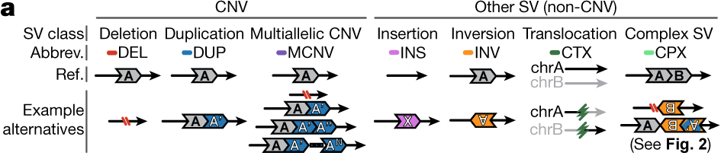
Advantages of SV calling in WGS
Human genome
Genome-wide coverage
Ability to capture full range of SV types
10,000x more SVs detected per genome
Collins, R.L., Brand, H., Karczewski, K.J. et al. (2020) Nature
Slide courtesy of Emma Pierce-Hoffman
Notes:
The advantages of resolution and scope that comes with WGS compared to WES naturally lend themselves well to characterizing Structural variation (SVs) across the genome in both coding and noncoding regions.
Not only that, whereas WES is only able to capture copy number variants (or CNVs), which include DEL, DUP, and MCNVs, WGS is able to capture other SVs in addition to CNVs. To include insertions, inversion, translocations, and other complex SV.
Together, this allows WGS to detect 10,000 times more SVs per genome than with WES
SV: genomic rearrangement of > 50 NT
Important contributor to human disease

Slide 29


SV discovery with GATK-SV
SV callers
Joint genotyping
Manta
MELT
Wham
cn.MOPS
Clustering
GATK-gCNV
Complex event resolution
Evidence types
Paired end
Split read
Filtering
Read depth
B-Allele frequency
Collins et al., Nature (2020)
Functional annotation
Notes:
Without going into too much detail, SVs were called and annotated using the GATK-SV pipeline

Slide 30
Characterization of SV sizes in WGSPD
Notes:
All of the previous benefits of WGS for SVs becomes a little more concrete here
Looking at the distribution of sizes across all SV types (different colors), we see that we have the resolution to confidently detect a range of SVs (sizes along the x axis) and these fall within expectations

Slide 31
Characterization of SV counts in gnomAD v4
Count of SVs per Genome
by population
Notes:
And finally, here’s the distribution of SVs detected stratified by inferred ancestry. It should be clear from the varying number of observations across ancestries that accounting for these diverse populations is extremely important for any similar analyses moving forward.

